Slide 1
Improved schedulability on the ρVEX polymorphic VLIW processor
Joost J. Hoozemans
Computer Engineering Laboratory
Delft University of Technology, The Netherlands
Thursday, 17 August 2017
RTCSA 2017, Hsingchu, Taiwan

Slide 2
Outline
Intro: ρVEX polymorphic (adaptable) VLIW processor
Static realtime scheduling
Challenge: When to perform adaptations
Approach
Results
Conclusions
RTCSA 2017, Hsingchu, Taiwan

Slide 3
Observation
Past
Future
Embedded workloads becoming increasingly dynamic
Intensity (nr. of tasks)
Characteristics (amount, type of parallelism)
Requirements (criticality)
RTCSA 2017, Hsingchu, Taiwan

Slide 4
Realization
Dynamic workloads call for dynamic computing platforms
RTCSA 2017, Hsingchu, Taiwan

Slide 5
Realization & Vision
Dynamic workloads call for dynamic computing platforms
Implementing a system that constantly adapts to all its running tasks
RTCSA 2017, Hsingchu, Taiwan

Slide 6
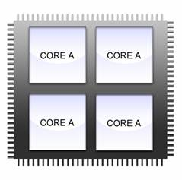
Old days
Homogeneous multicores
RTCSA 2017, Hsingchu, Taiwan

Slide 7
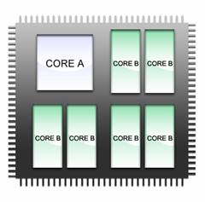
Current state-of-the-art
Heterogeneous multicores
RTCSA 2017, Hsingchu, Taiwan

Slide 8
Current state-of-the-art
Heterogeneous multicores
RTCSA 2017, Hsingchu, Taiwan

Slide 9
Heterogeneous Multicore processors
Task 2
Core A
Underutilization
Task 1
Save
Task 1
Restore
Task 2
Unused ILP
Task 2
Save
Task 2
Restore
Task 1
Task 1
Core B
t
Migration penalty!
RTCSA 2017, Hsingchu, Taiwan
Notes:
TODO: draw or explain that vertical ‘axis’ is ILP/core utilization

Slide 10
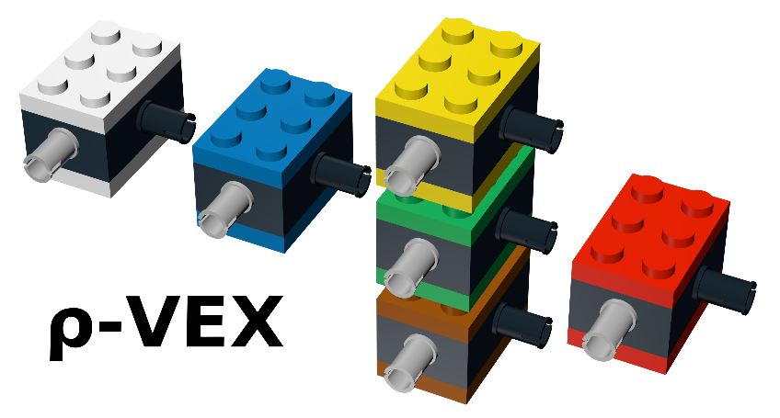
Solution: ρVEX adaptible VLIW processor
Dynamic processor
Assigning datapaths to threads
Datapath 1 & 2
Datapath 3 & 4
Datapath 5 & 6
Datapath 7 & 8
t
RTCSA 2017, Hsingchu, Taiwan
Notes:
TODO: not clear what the datapaths are here

Slide 11
Solution: ρVEX adaptible VLIW processor
Dynamic processor
Assigning datapaths to threads
Task 2
Task 2
Task 2
Task 2
Task 4
Task 3
Task 1
Task 3
t
5 clock cycles adaptation penalty
RTCSA 2017, Hsingchu, Taiwan

Slide 12
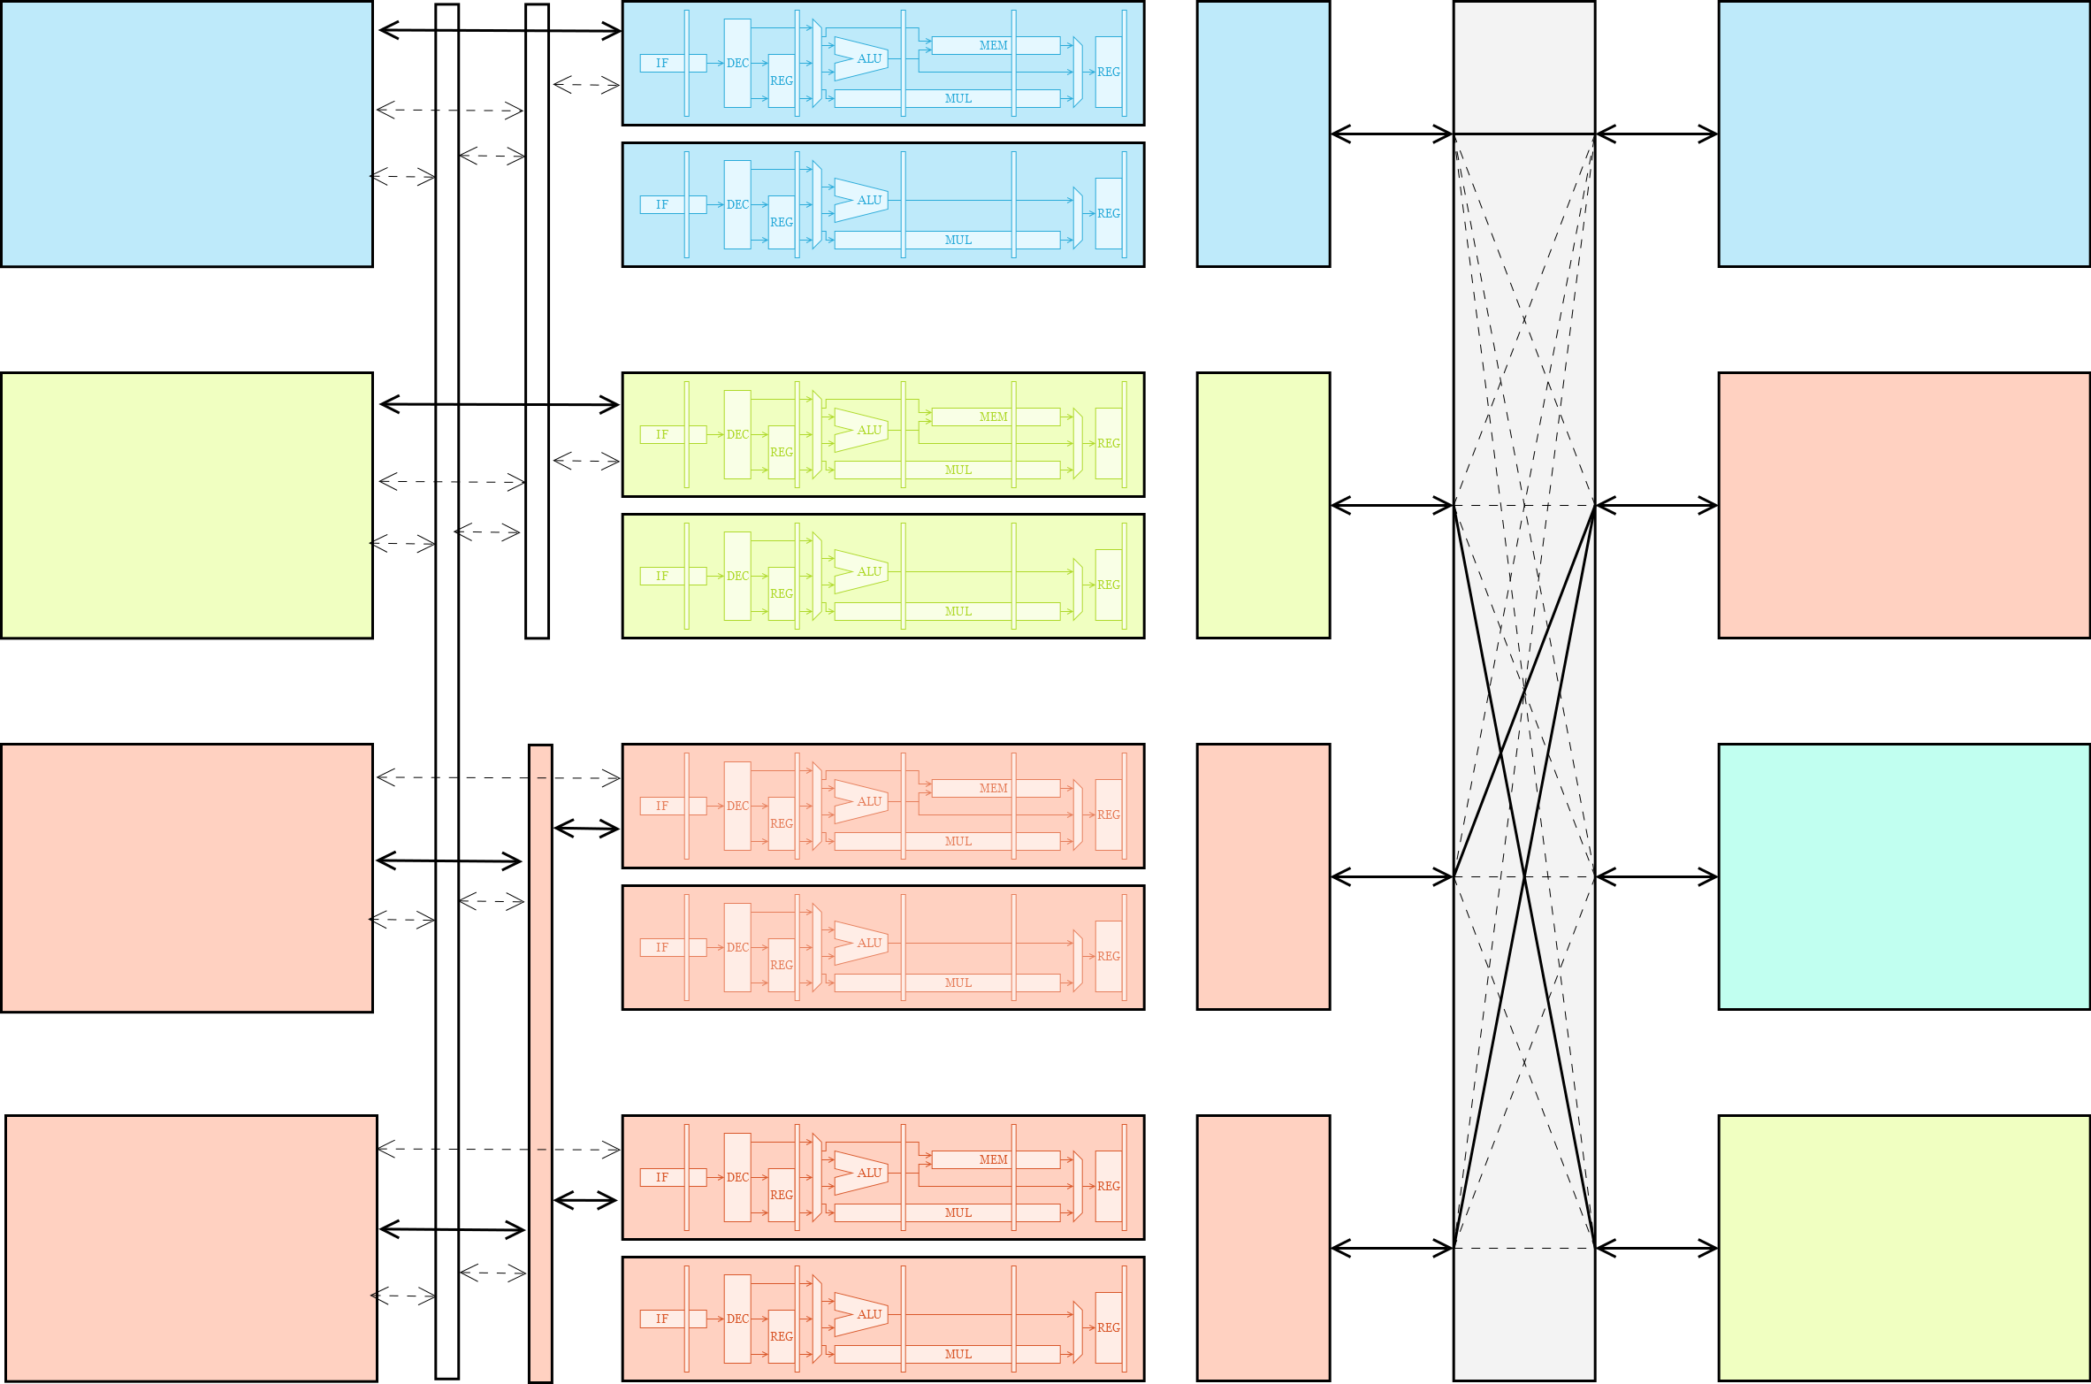
Datapath
Cache block 1
Control
Task 1
State storage
Datapath
Datapath
Cache block 2
Control
Task 2
State storage
Datapath
Datapath
Cache block 3
Control
Task 3
State storage
Datapath
Datapath
Cache block 4
Control
Task 4
State storage
Datapath
RTCSA 2017, Hsingchu, Taiwan
Notes:
Similar to SMT, but with performance isolation

Slide 13
Datapath
Cache block 1
Control
Task 1
State storage
Datapath
Datapath
Cache block 2
Control
Task 2
State storage
Datapath
Datapath
Cache block 3
Control
Task 3
State storage
Datapath
Datapath
Cache block 4
Control
Task 4
State storage
Datapath
RTCSA 2017, Hsingchu, Taiwan
Notes:
Similar to SMT, but with performance isolation

Slide 14
Datapath
Cache block 1
Control
Task 1
State storage
Datapath
Datapath
Cache block 2
Control
Task 2
State storage
Datapath
Datapath
Cache block 3
Control
Task 3
State storage
Datapath
Datapath
Cache block 4
Control
Task 4
State storage
Datapath
RTCSA 2017, Hsingchu, Taiwan
Notes:
Similar to SMT, but with performance isolation

Slide 15
Datapath
Cache block 1
Control
Task 1
State storage
Datapath
Datapath
Cache block 2
Control
Task 2
State storage
Datapath
Datapath
Cache block 3
Control
Task 3
State storage
Datapath
Datapath
Cache block 4
Control
Task 4
State storage
Datapath
RTCSA 2017, Hsingchu, Taiwan
Notes:
Similar to SMT, but with performance isolation

Slide 16
Datapath
Cache block 1
Control
Task 1
State storage
Datapath
Datapath
Cache block 2
Control
Task 2
State storage
Datapath
Datapath
Cache block 3
Control
Task 3
State storage
Datapath
Datapath
Cache block 4
Control
Task 4
State storage
Datapath
RTCSA 2017, Hsingchu, Taiwan
Notes:
Similar to SMT, but with performance isolation

Slide 17
ρVEX VLIW processor – Advantages
High single-thread performance
High multi-thread throughput
Low configuration overhead (no migration penalties)
Low interrupt latency
RTCSA 2017, Hsingchu, Taiwan

Slide 18
ρVEX VLIW processor – Advantages
High single-thread performance
High multi-thread throughput
Low configuration overhead (no migration penalties)
Low interrupt latency
Static Real-time Schedulability
RTCSA 2017, Hsingchu, Taiwan

Slide 19
Static real-time schedulability
Advantage 1:
Each task has n configuration options
Each with a distinct WCET
Task 1
Task 1
Task 1
2-issue:
250,000 cycles
4-issue:
200,000 cycles
8-issue:
160,000 cycles
RTCSA 2017, Hsingchu, Taiwan
Notes:
Could consider using this one instead of the next

Slide 20
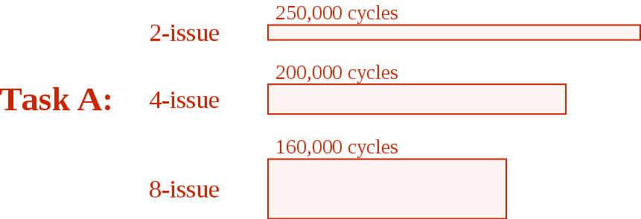
Static real-time schedulability
Advantage 1:
Each task has n configuration options
Each with a distinct WCET
RTCSA 2017, Hsingchu, Taiwan
Notes:
This provides more flexibility in creating a valid schedule. If one configuration does not meet the deadline, you can run it in another configuration.

Slide 21
Static real-time schedulability
Advantage 1:
Each task has n configuration options
Each with a distinct WCET
RTCSA 2017, Hsingchu, Taiwan
Notes:
In this case, only 2 of the 3 options can create a valid schedule. Other task with lower utilizations can run in 2-issue

Slide 22
Static real-time schedulability
Advantage 2:
Adaptations can be performed at any time
Each task can run in their preferred configuration
t
RTCSA 2017, Hsingchu, Taiwan
Notes:
As we will see shortly, this situation where periods are aligned is not realistic and we will present a solution

Slide 23
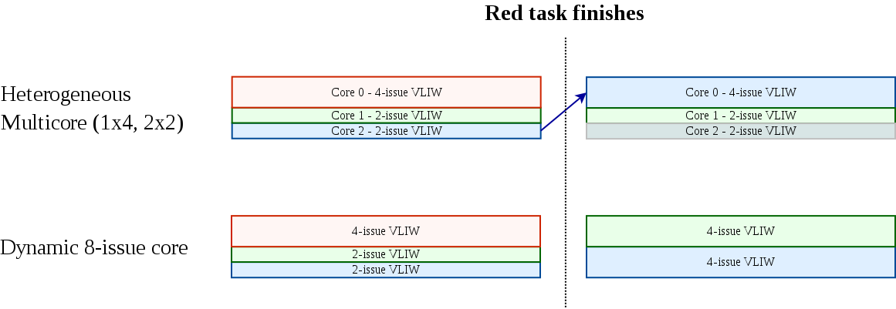
Static real-time schedulability
Advantage 3:
Compute resources can always be fully utilized
(as opposed to heterogeneous systems)
t
RTCSA 2017, Hsingchu, Taiwan

Slide 24
Static real-time schedulability
Advantage 3:
Compute resources can always be fully utilized
(as opposed to heterogeneous systems)
Idle!
Migration penalty!
t
RTCSA 2017, Hsingchu, Taiwan

Slide 25
Challenge: When to perform adaptations
RTCSA 2017, Hsingchu, Taiwan

Slide 26
When to perform adaptations
Problem 1: execution phases
RTCSA 2017, Hsingchu, Taiwan
Notes:
The problem is; we don’t know these phases. You can measure it but then it is too late.
(and it would probably be too complex to schedule if we did)

Slide 27
When to perform adaptations
Problem 1: execution phases
8-issue
4-issue
RTCSA 2017, Hsingchu, Taiwan
Notes:
The problem is; we don’t know these phases. You can measure it but then it is too late.
(and it would probably be too complex to schedule if we did)

Slide 28
When to perform adaptations
Problem 1: execution phases
8-issue
4-issue
4-issue
8-issue
RTCSA 2017, Hsingchu, Taiwan
Notes:
The problem is; we don’t know these phases. You can measure it but then it is too late.
(and it would probably be too complex to schedule if we did)

Slide 29
When to perform adaptations
Problem 1: execution phases
A task must always be executed in the same configuration
(otherwise, the WCET may not be valid)
RTCSA 2017, Hsingchu, Taiwan

Slide 30
When to perform adaptations
Problem 1: execution phases
A task must always be executed in the same configuration
(otherwise, the WCET may not be valid)
RTCSA 2017, Hsingchu, Taiwan

Slide 31
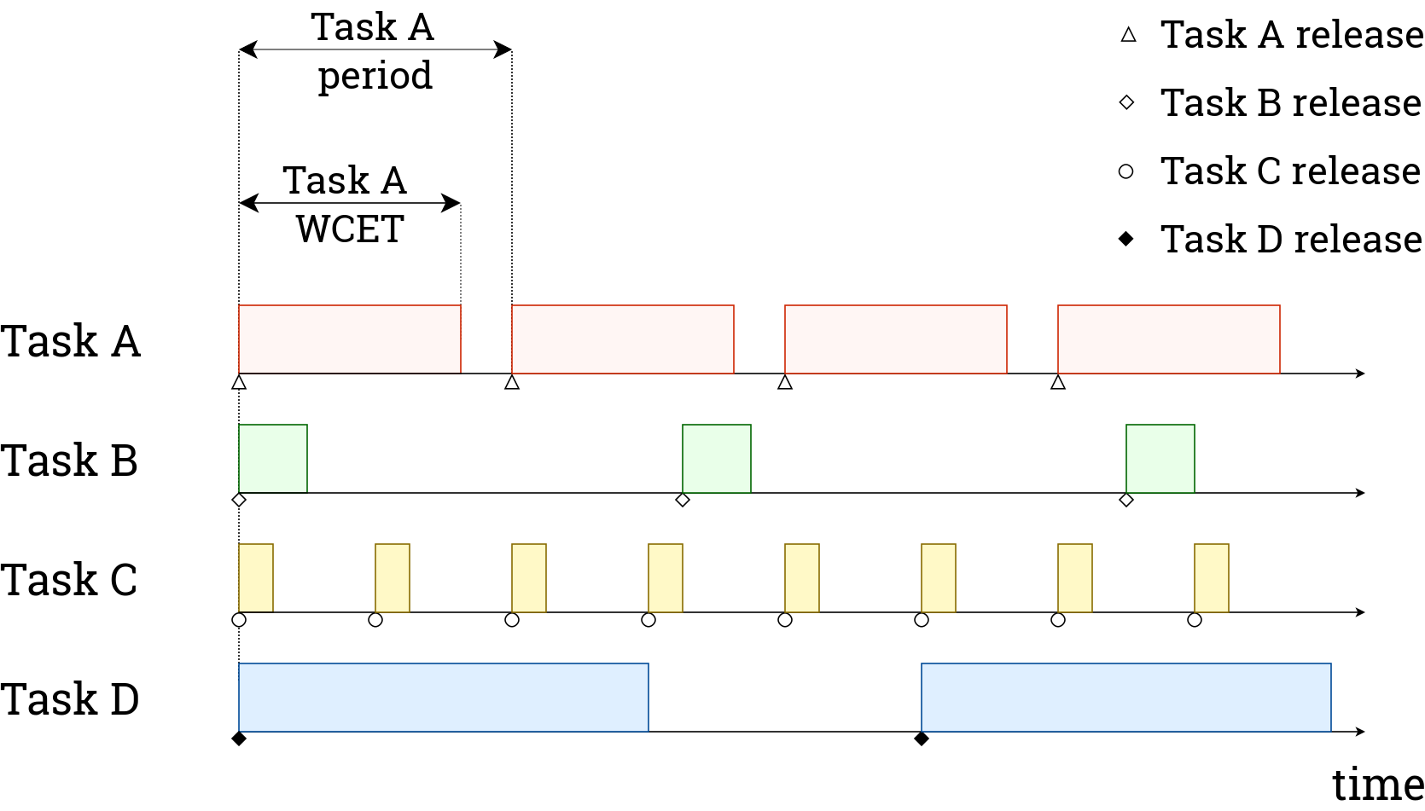
When to perform adaptations
Problem 2: different periods
RTCSA 2017, Hsingchu, Taiwan
Notes:
If a task must always run in the same config, it quickly becomes impossible to create a static schedule that guarantees this and also meets all the deadlines.
Even if this is possible, finding such a schedule for the entire hyperperiod results in a very large search space

Slide 32
When to perform adaptations
?
Problem 2: different periods
RTCSA 2017, Hsingchu, Taiwan

Slide 33
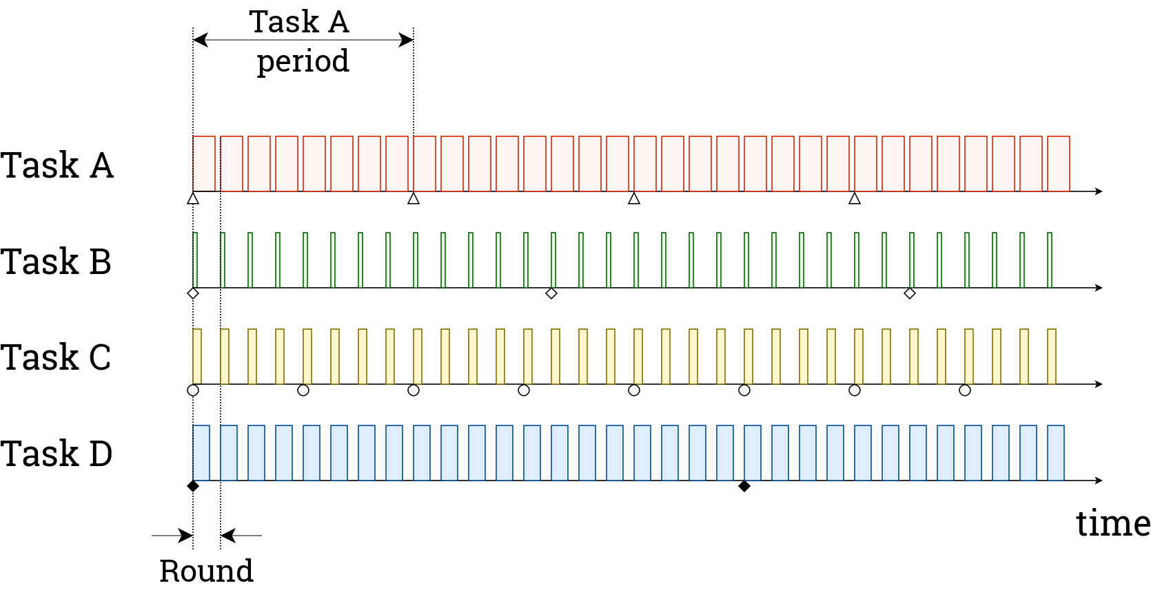
Approach
Solution: divide execution into ‘rounds’ of fixed length
RTCSA 2017, Hsingchu, Taiwan

Slide 34
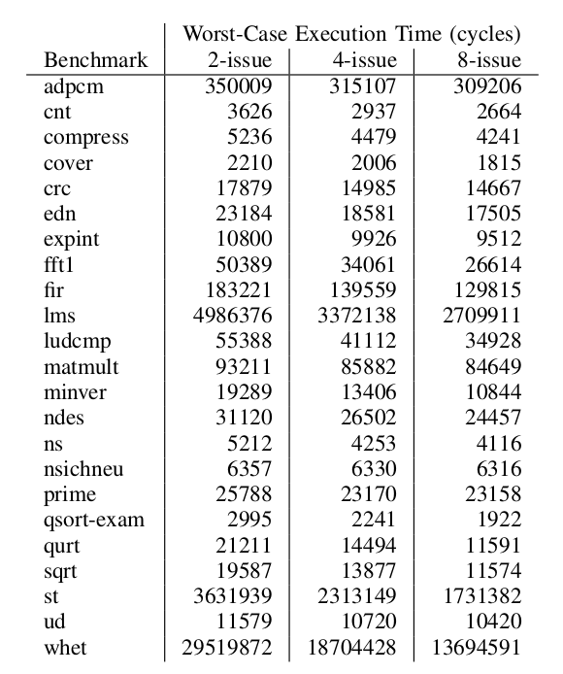
Approach
1: Measure WCETs
for each configuration
RTCSA 2017, Hsingchu, Taiwan

Slide 35
Approach
1: Measure WCETs
for each configuration
RTCSA 2017, Hsingchu, Taiwan

Slide 36
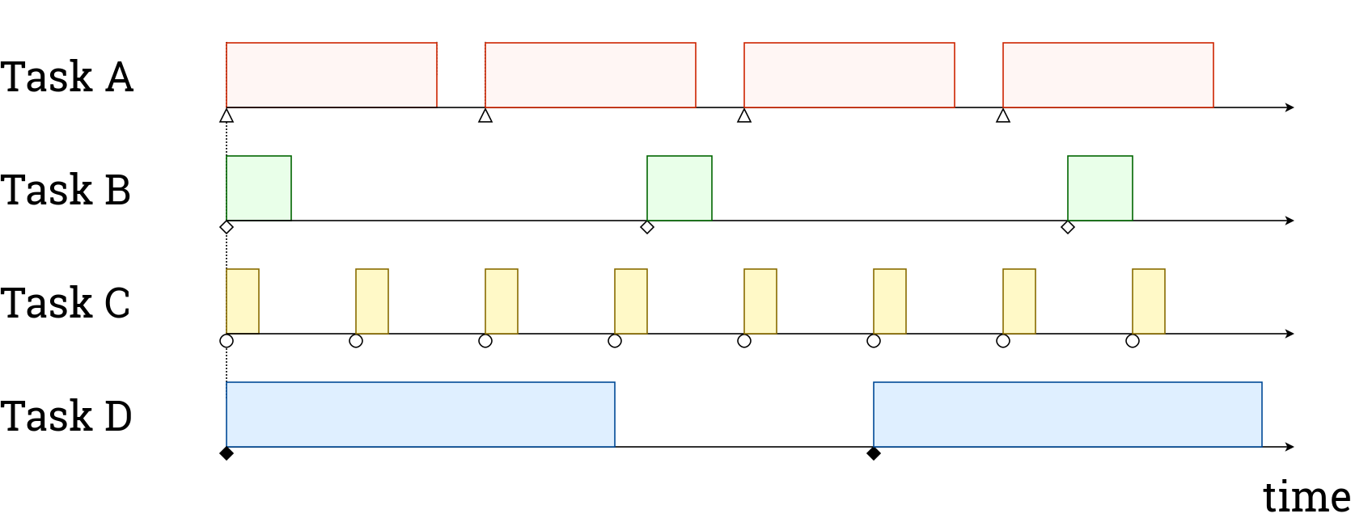
Approach
2: calculate utilizations (for each configuration)
Issue width:
2 4 8
125%
100%
80%
30%
20%
15%
30%
25%
25%
110%
70%
60%
RTCSA 2017, Hsingchu, Taiwan

Slide 37
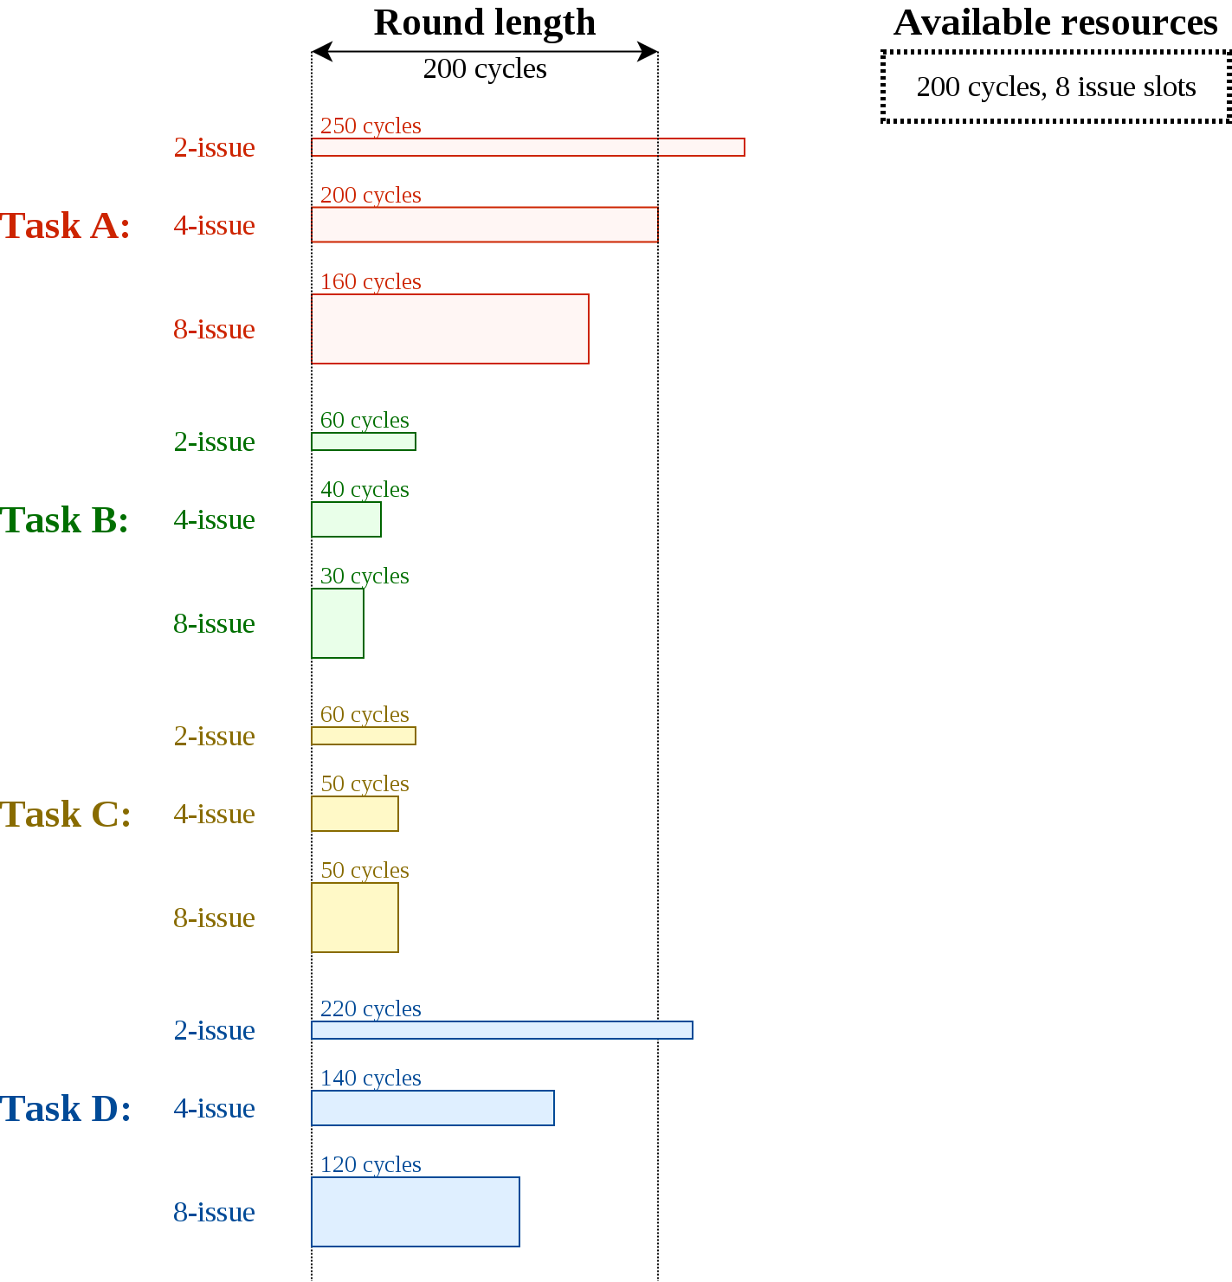
Approach
3: Choose a round length,
calculate resource utilization (issue slots, time)
RTCSA 2017, Hsingchu, Taiwan

Slide 38
Approach
4: Fit shapes into the area representing available resources
Time, issue slots (datapaths)
RTCSA 2017, Hsingchu, Taiwan

Slide 39
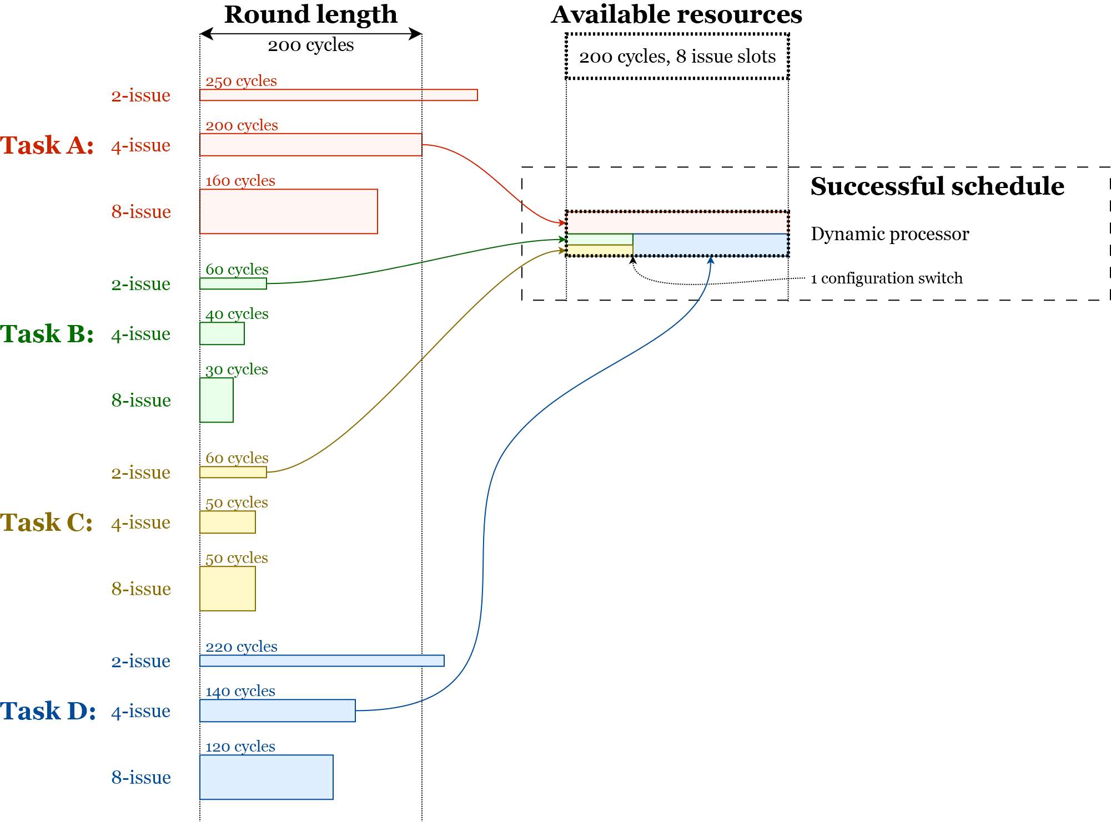
Approach

Slide 40
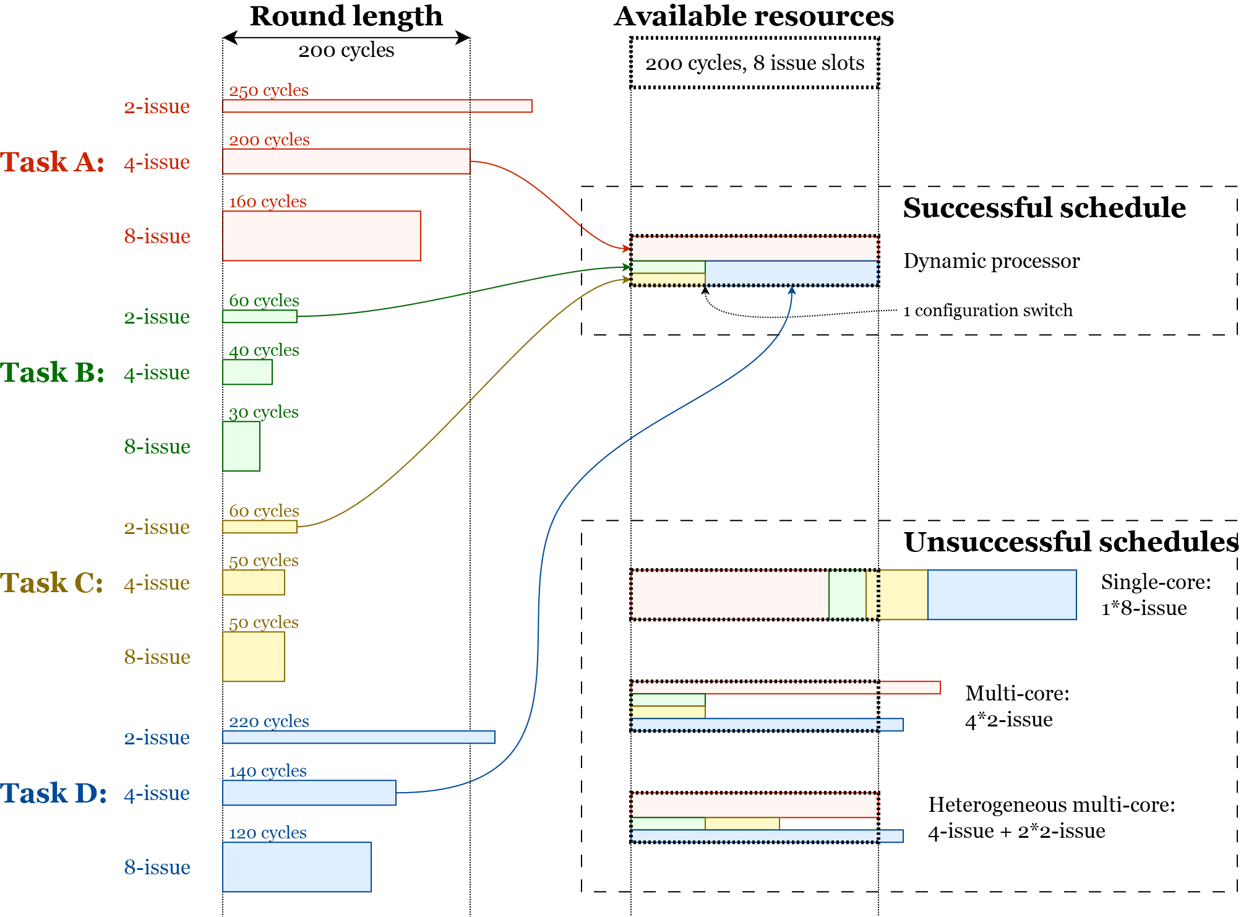
Approach

Slide 41
Results - Schedulability
Comparing platforms
Equal computational resources (8 datapaths)
8-issue
4-issue
2-issue
4-issue
2-issue
4-issue
2-issue
2-issue
2-issue
2-issue
Single core
(1x 8-issue)
Homogeneous Multicore
(2x 4-issue)
Homogeneous Multicore
(4x 2-issue)
Heterogeneous Multicore
(1x 4-issue,
2x 2-issue)
RTCSA 2017, Hsingchu, Taiwan

Slide 42
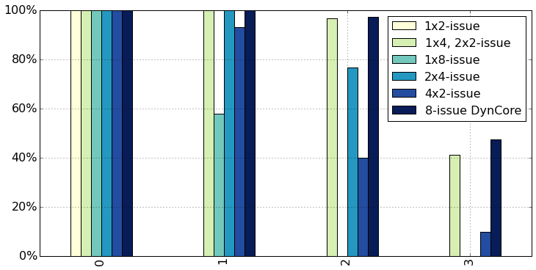
Results - Schedulability
nTasks = 4
Total Utilization
RTCSA 2017, Hsingchu, Taiwan

Slide 43
Results - Schedulability
nTasks = 4
15%
Total Utilization
RTCSA 2017, Hsingchu, Taiwan

Slide 44
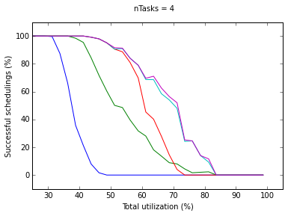
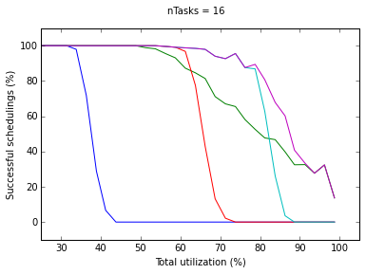
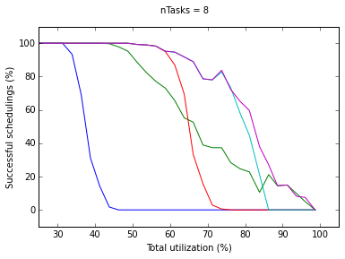
Results - Schedulability
Advantage increases with higher
utilization
RTCSA 2017, Hsingchu, Taiwan

Slide 45
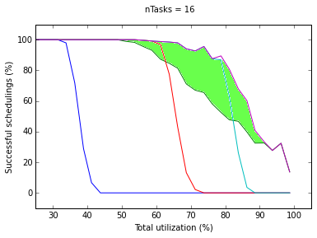
Results - Schedulability
Advantage increases with higher
utilization
RTCSA 2017, Hsingchu, Taiwan

Slide 46
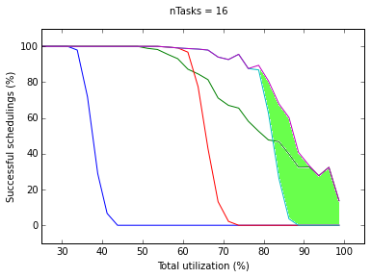
Results - Schedulability
Advantage increases with higher
utilization
RTCSA 2017, Hsingchu, Taiwan

Slide 47
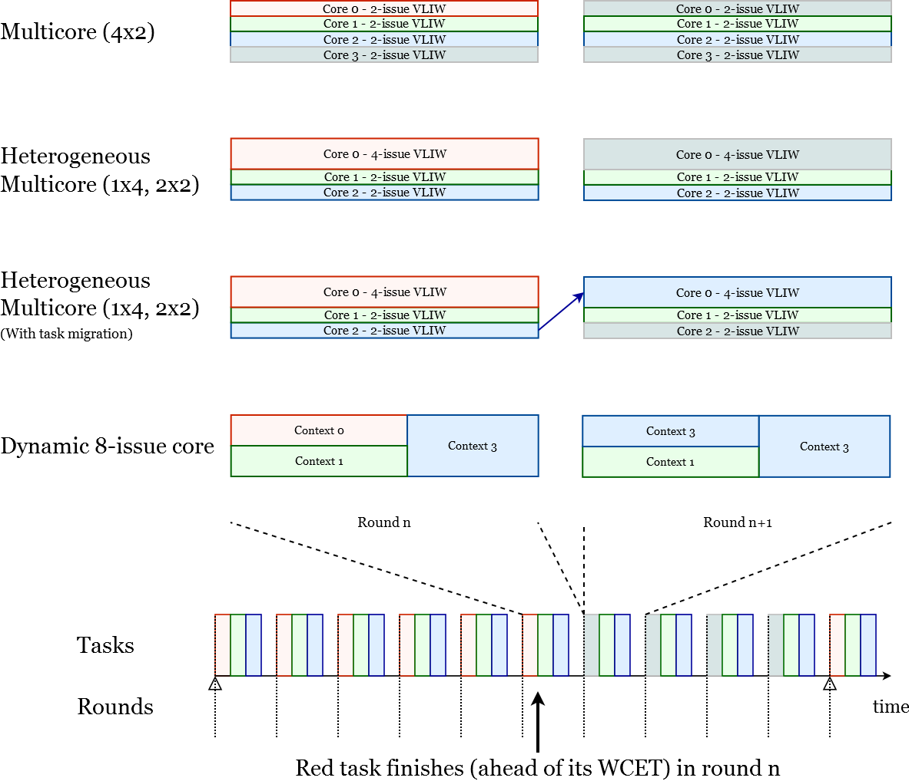
Mixed-criticality workloads
Full resource utilization
(better performance
for non-critical tasks)
RTCSA 2017, Hsingchu, Taiwan
Notes:
TODO: split and build up

Slide 48
Conclusions
The adaptable processor:
Provides improved schedulability compared to heterogeneous and homogeneous multicore systems with equal computational resources
Improvements of at least 15% for task graphs with high utilization
Prevents migration penalties
Allows full resource utilization
RTCSA 2017, Hsingchu, Taiwan

Slide 49
http://rvex.ewi.tudelft.nl
RTCSA 2017, Hsingchu, Taiwan

Slide 50
Platform
Open-source (academic)
Highly generic VHDL design
Debugging hardware, interface, tools
Fast architectural simulator
Binutils, Compilers, Libraries
OS support (uCLinux, FreeRTOS)
MiBench, PolyBench, SPECint 2006
Zedboard, ML605, VC707
http://rvex.ewi.tudelft.nl
RTCSA 2017, Hsingchu, Taiwan

Slide 51
Platform
Open-source (academic)
Labs, Tutorials available
Embedded Computer Architecture (Msc. Course)
(VLIW) Computer Architecture Research
Msc. Thesis topics
VHDL design
Tools, compilers, Operating Systems, Libraries, benchmarks, …
http://rvex.ewi.tudelft.nl
RTCSA 2017, Hsingchu, Taiwan

