Slide 1
Liquid Architectures: Linux on rVEX
Joost J. Hoozemans – Computer Engineering, TU Delft
Thursday, 08 October 2015

Slide 2
Liquid Architectures
A Definition
Run-time adaptivity of computing systems (processors, memories, network-on-chips)
to meet changing requirements
of applications being executed
in different environments

Slide 3
Liquid Architectures
Vision
Implementing a system that constantly optimizes its hardware for all its running tasks

Slide 4
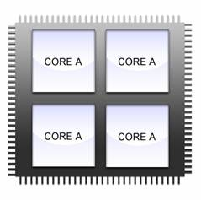
Old days
Homogeneous multicores

Slide 5
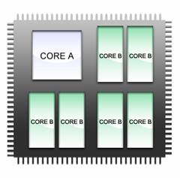
Current state-of-the-art
Heterogeneous multicores

Slide 6
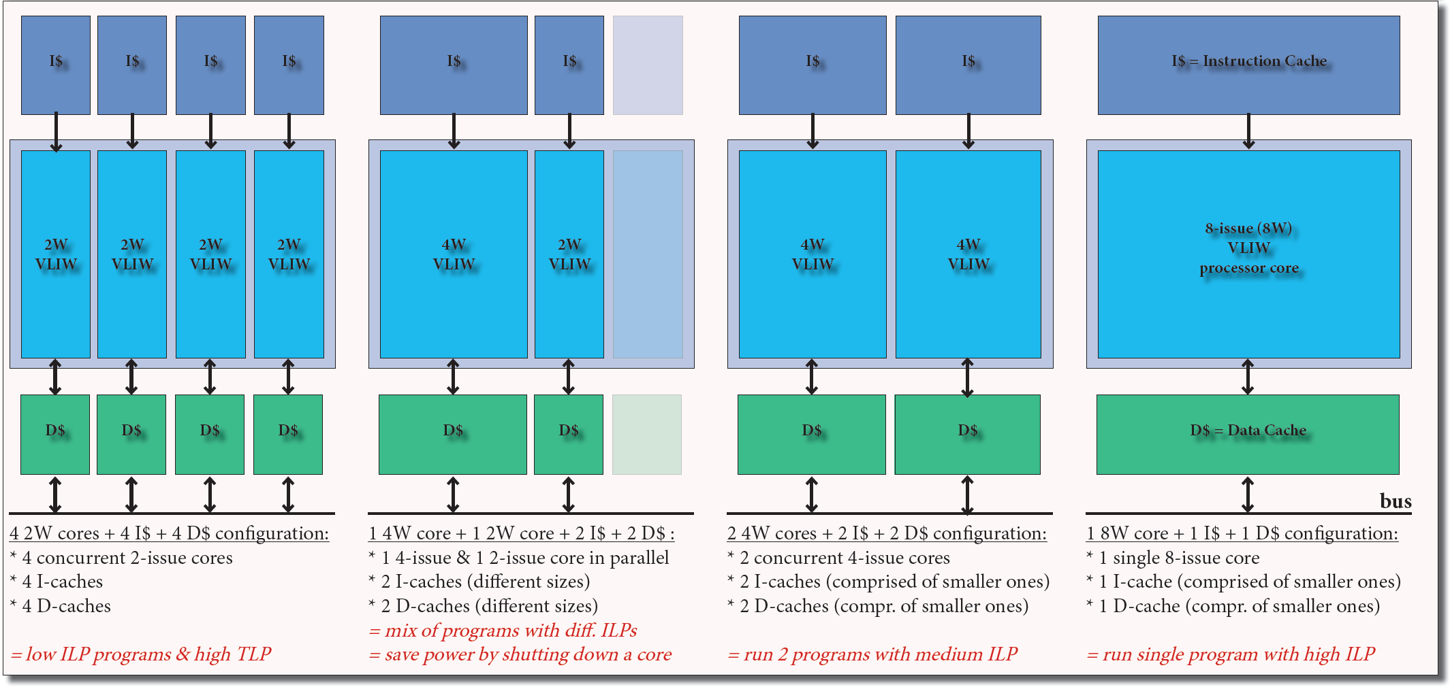
Dynamic ρ-VEX core (2015)

Slide 7
ρ-VEX
Origins
VEX: Design-space exploration tool for VLIW processors
Parameters
Issue width
Number of registers
Number of Functional Units (ALU, ...)
Simulation system

Slide 8
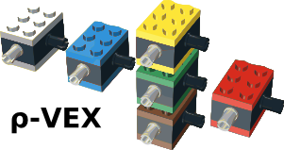
ρ-VEX
Origins
ρ-VEX: VHDL implementation of the VEX ISA
Parametrized
Design-time reconfigurable
Issue width
Nr of Functional units
ISA extensions
Run-time parametrizable
Issue width

Slide 9
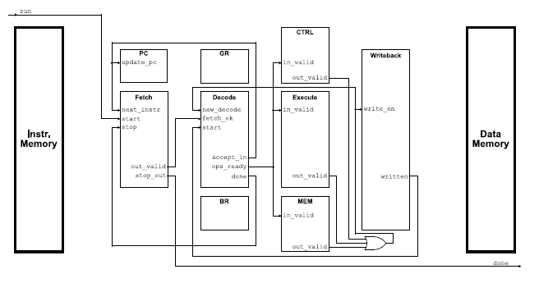
ρ-VEX
Development
Thijs van As: version 1.0
Multi-cycle, non-pipelined design
No caches
89 MHz on Virtex 2

Slide 10
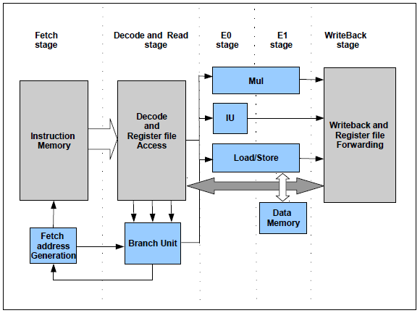
ρ-VEX
Development
Roël Seedorf, Anthony Brandon, Fakhar Anjam: version 2.0
Redesign
Pipelining, forwarding
Dynamic
No caches
117 MHz on Virtex 6

Slide 11
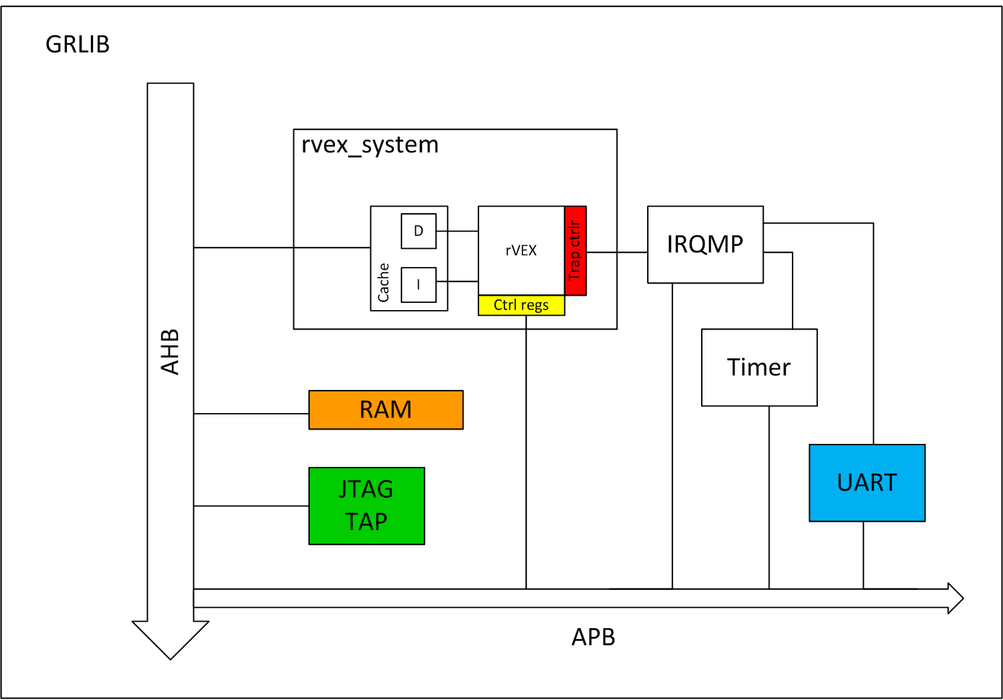
ρ-VEX
Development
Bhavisha Goel, Me: version 3.0
SoC
caches
75 MHz on Virtex 6
Not dynamic due to
caches

Slide 12
ρ-VEX
Development
Bhavisha Goel, Me: version 3.0
SoC
caches
75 MHz on Virtex 6
Not dynamic due to
caches
Started with Linux

Slide 13
ρ-VEX
Development
Jeroen Van Straten: version 4.0
Redesign
Dynamic core, dynamic cache
Generic design (architectural parameters AND pipeline organization)
Precise traps, extensive debugging hardware
75 MHz on Virtex 7

Slide 14
Dynamic ρ-VEX core (2015)
Dynamic reconfiguration (5 cycles), multiple context support, cache resizing, snooping cache
Precise interrupts, configuration via memory-mapped registers, dynamic trace unit, support for breakpoints and single stepping through application codes, gdb support, Linux (2.0) running.

Slide 15
The Need for an Operating System
Leveraging the power of the ρ-VEX

Slide 16
The need for an Operating System
Why do we need an OS?
Reconfigurations need to be controlled
Notes:
So now we have seen that we can optimize our processors hardware for different kinds of programs, as stated in our vision.
The question is; how do we control these reconfigs? We need some kind of program for that.
It needs to know what configuration is best for a program, and change it automatically.
That is where the OS comes in.

Slide 17
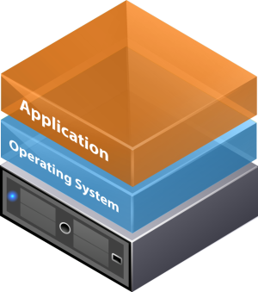
The need for an Operating System
Why do we need an OS?
Reconfigurations need to be controlled
Notes:
The OS is a layer between programs and the hardware.
The goal is to have the OS find out what the best hardware configuration for all of its tasks is,
and then run them all as efficiently as possible.

Slide 18
The need for an Operating System
OS running on ρ-VEX
Task 2
ILP
Task 1
User
t
Save
Task 1
Schedule
Restore
Task 2
System
Notes:
This is what an OS is doing all the time. Switching between different task a hundred times per second.
This is how it seems as if all your programs are running at the same time; time sharing.

Slide 19
The need for an Operating System
OS running on ρ-VEX
Task 2
ILP
Task 1
User
t
Save
Task 1
Schedule
Restore
Task 2
System
OS can reconfigure the ρ-VEX core during task switch
Using statically found optimal hardware configurations
Using performance counters to measure runtime characteristics (NOPs)
Provides optimal configuration for all its tasks
Notes:
We would like to extend the job of process switching a little bit:
The OS will check the program and see how it is running. It will make a prediction about what configuration will be best when resuming this task.
This prediction can be based on execution phase characterisation found by static analysis by the compiler, but I also plan on designing performance monitoring hardware that measures certain runtime characteristics.
As we can see, Task 1 is a different kind of program than Task 2. It is running on a small core. Task 2 is predicted to be more suitable for a wide core.
Before resuming, the OS should reconfigure the core.

Slide 20
The need for an Operating System
OS running on ρ-VEX
Task 2
Task 1
User
t
Evaluate
Save
Task 1
Schedule
Restore
Task 2
Re-configure
System
OS can reconfigure the ρ-VEX core during task switch
Using statically found optimal hardware configurations
Using performance counters to measure runtime characteristics (NOPs)
Provides optimal configuration for all its tasks
Notes:
This is how that would look like.
Of course, there is an enormous amount of challenges involved in this evaluation, prediction, and how and when to do the reconfiguration.
But this is the general idea of how I think we can create our envisioned system.
This also makes it clear why we need to port an operating system to rVEX.

Slide 21
The need for an Operating System
OS running on ρ-VEX
Task 2
Task 1
User
t
Evaluate
Save
Task 1
Schedule
Restore
Task 2
Re-configure
System
Notes:
This is how that would look like.
Of course, there is an enormous amount of challenges involved in this evaluation, prediction, and how and when to do the reconfiguration.
But this is the general idea of how I think we can create our envisioned system.
This also makes it clear why we need to port an operating system to rVEX.

Slide 22
The need for an Operating System
OS running on ρ-VEX
Task 2
Task 1
User
t
Evaluate
Save
Task 1
Schedule
Restore
Task 2
Re-configure
System

Slide 23
The need for an Operating System
Task 2
Task 1
User
t
Schedule
Re-configure
System

Slide 24
Liquid Computing
Datapath 1 & 2
Datapath 3 & 4
Datapath 5 & 6
Datapath 7 & 8
t

Slide 25
Liquid Computing
Task 2
Task 1
Reconf
t

Slide 26
Liquid Computing
Task 2
Task 1
Reconf
t

Slide 27
Liquid Computing
Task 5
Task 2
Task 4
Task 3
Task 1
Reconf
t

Slide 28
Liquid Computing
Interrupt
Task 5
Task 2
Reconf
Task 2
Task 2
Task 4
Task 3
Task 1
Reconf
Task 3
Reconf
t

Slide 29
Liquid Computing
5 Cycles!
Task 5
Task 2
Reconf
Task 2
Task 2
Task 4
Task 3
Task 1
Reconf
Task 3
Reconf
t

Slide 30
Liquid Computing
Goal
Task 5
Task 2
Reconf
Task 2
Task 2
Task 4
Task 3
Task 1
Reconf
Task 3
Reconf
t

Slide 31
Liquid Computing
Current state
Task 2
Task 1
Reconf
t

Slide 32
Hardware development
Hardware requirements for Linux

Slide 33
Hardware development
Requirements
Processor
Main memory
Modified Harvard architecture – single address-space
Adequate size
Serial connection
Trap/Interrupt Facility
Timer
Debugger
Not strictly required
Notes:
So what do you need to run an OS?
We need a processor; ok check.
We need memory, preferably a decent amount. rVEX normally uses separate instruction and data memories but we need a single address space.
We want to be able to communicate with the system, to see that it actually does something.
We need the core to be interruptable, and it must be able to handle traps.
We need a timer to generate timer interrupts, because Linux is a time-sharing system.
For efficient debugging, we decided to add a debug unit in hardware (actually the most important reason was that I wanted to know how those things work so I created one for myself)

Slide 34
Hardware development
Platform setup
Initial platform: GRLIB-based
Main memory, caches
UART serial interface for console
Interrupt controller
Timer
Additions needed
Trap facility in the ρ-VEX core
Debugger
Notes:
We started with a platform based on GRLIB, that already met most of the requirements.
We evaluated it and found some additions were needed.

Slide 35
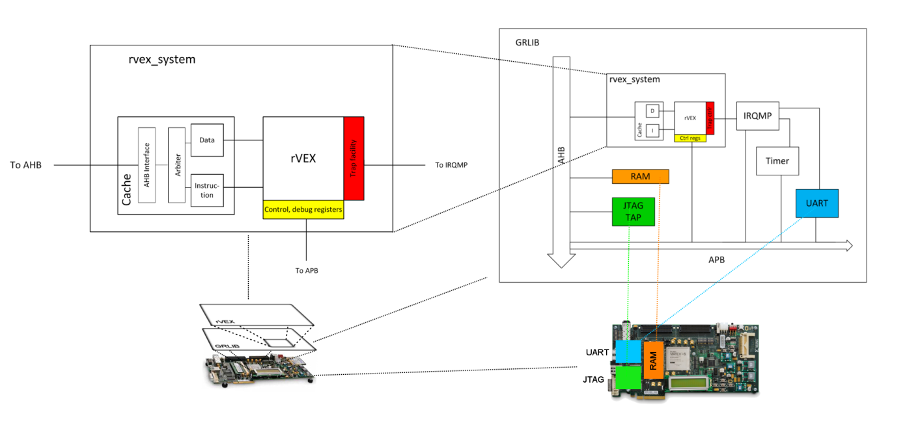
Hardware development
Platform setup
Notes:
Platform overview

Slide 36
Linux
Adding the VEX architecture to the Linux 2.0 kernel

Slide 37
Linux
Introduction
Free, Open source
Runs on 80% of all smartphones
Runs on 80% of all supercomputers
Portable
No MMU? => uCLinux!
2.0 kernel

Slide 38
Linux
NO_MMU
No virtual memory
No memory protection
No paging (also no swapping)
No dynamic stack
Malloc uses global shared memory pool (no brk() )

Slide 39
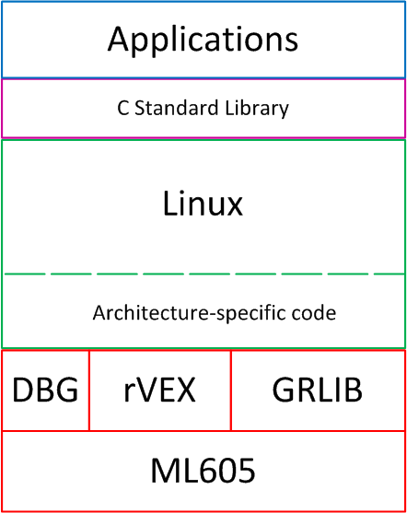
Linux
Components
Only Linux kernel
No applications
Add Arch/code
Mostly assembly
Notes:
What I needed to do, is essentially add Architecture-specific code for my rVEX platform.

Slide 40
Linux
Porting steps
Created architecture-specific files
Derived from similar architectures
Write initialization code
Write Interrupt handling code
Only timer interrupts
Write process switching code
Fork()
Create and mount root filesystem
System calls
Partly in libc

Slide 41
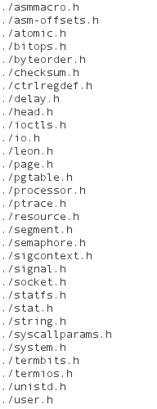
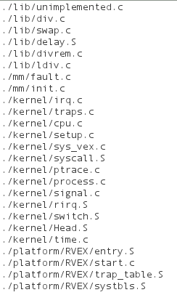
Linux
Architecture-specific code

Slide 42
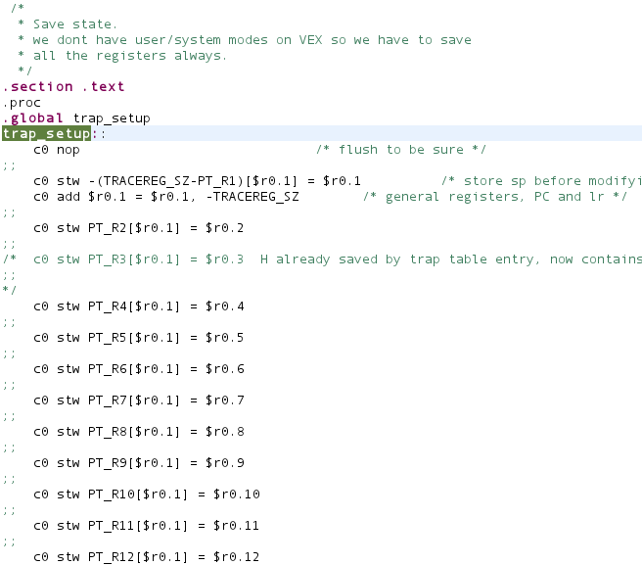
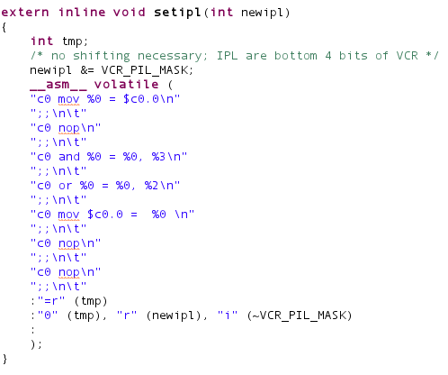
Linux
Architecture-specific code

Slide 43
Linux
Workflow
Write new code
Compile kernel
Run on board
Wait for it to crash
Fix problems
Notes:
“Wait for it to crash” was the only part of the whole project that didn’t take a very long time!

Slide 45
Current/Future work
Simultaneous Multi-Processing
Memory Management Unit
Reconfiguration scheduling algorithms

Slide 48
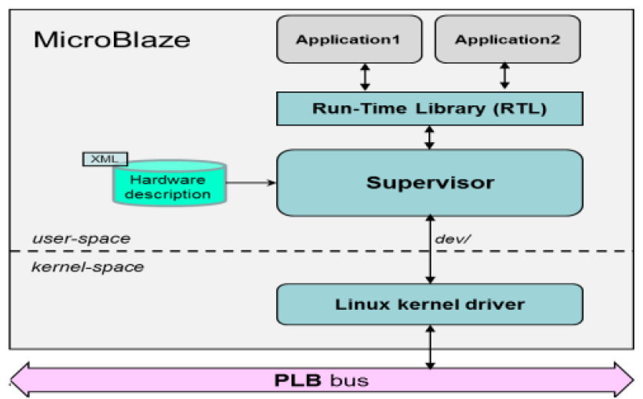
The need for an Operating System
ERA – Embedded Reconfigurable Architectures
Needs a separate processor to run the OS
Inefficient!
Main processor
Program
Co-processor
ρ-VEX
Notes:
Lets discuss the way this is done currently; The ERA approach.
The system is running the applications on a separate processor. A programmer must manually extract parts of the program to run on the rVEX coprocessor.
The system must then reconfigure the core (if applicable), transfer the program and its data to the core, signal it to start and then wait for it to finish before it can get the result back!
This results in large overheads and is quite inefficient.
This approach has the same drawbacks as hardware-software compilation but without the increased performance.

Slide 49
Hardware development
Trap controller
Trap/Exception: Anomaly during execution
SPARC-based Vectored Trap controller
Connects to GRLIB Interrupt controller
VEX Control Registers: VCR
rVEX: “Hardware unavailable” exception
Notes:
An interesting option For our rVEX system: a special exception can be created when optimizing the core for minimal area usage.
The OS can decide that some application has not executed a multiply operation for far too long.
It will switch off the unused MUL units or assign them to another core that needs them more.
When the program DOES try to perform a multiplication, this will generate an exception.
Instead of crashing, the operating system will reconfigure the core, WITH MUL units and execution can resume normally. This is future work.

Slide 50
Hardware development
Trap controller
Trap/Exception: Anomaly during execution
Interrupts
System calls
SPARC-based Vectored Trap controller
Connects to GRLIB Interrupt controller
VEX Control Registers: VCR
Notes:
To control the trap unit, I added a new type of register to the register file: control register.
I named them after a needlessly complicated piece of machinery that everyone used to own, but no one knew how to program.

Slide 51
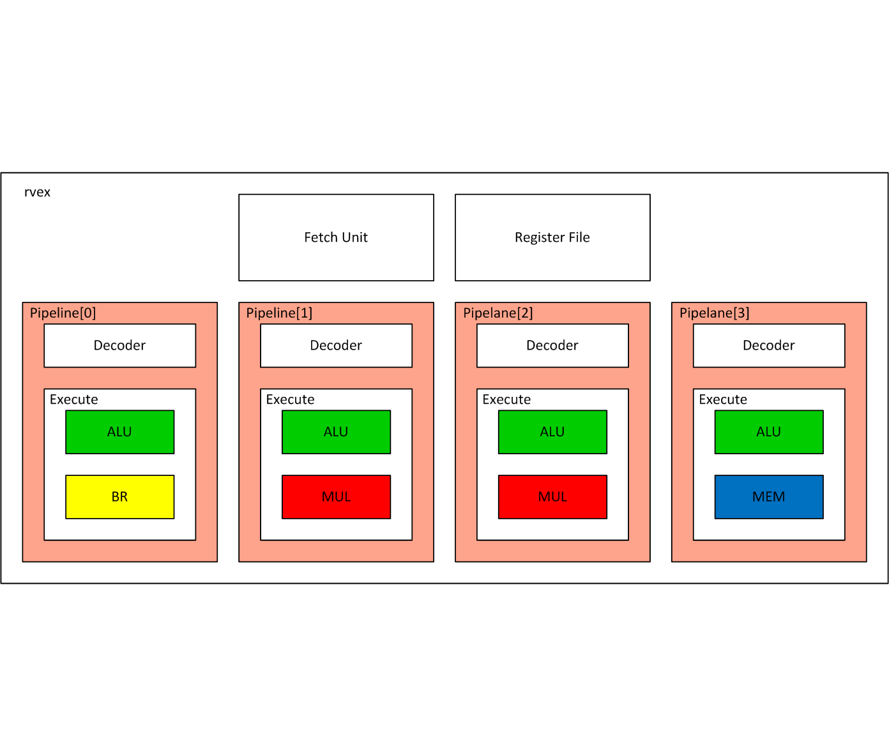
Computer Architecture
ρ-VEX : reconfigurable VLIW softcore
Flexible hardware:
Solve VLIW drawbacks
Variable issue-width; minimize NOPs
Binary compatibility; ρ-VEX can morph into any core design
Increase resource utilization
Notes:
To remove these drawbacks, TU Delft has developed a VLIW softcore that is FLEXIBLE.
We use reconfigurable hardware to be able to change the processor design.
The processor has parameters that can be changed. The most important one is the issue-width; this is the number of pipelanes in a processor.
The pipelanes contain the functional units, so this parameter defines how many instructions the processor can execute at the same time.
This removes the drawbacks in the following ways; for applications with low parallelism, we change the core to a small issue width (minimizing NOPs).
For apps with high parallelism, we change the core to a wide issue width (maximizing performance).
Binary compatibility is no problem; a program is compiled for a certain configuration (parameter set). We just change the core to that configuration before starting the program.
So we can SOLVE the VLIW drawbacks using the hardware flexibility we gained from reconfigurable hardware (answering our earlier question).
But theres more. The rVEX is quite unique.

Slide 52
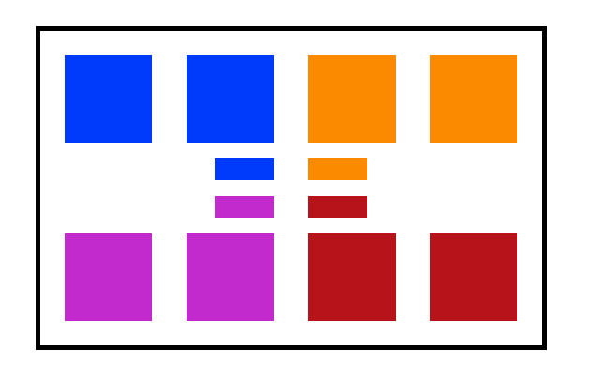
Computer Architecture
ρ-VEX : reconfigurable VLIW softcore
Notes:
Suppose this is your FPGA. There is room to place 8 pipelanes in there (the large squares), and control logic for 4 rVEX cores (the small squares).
We can then configure this into 4 cores with 2 pipelanes each,

Slide 53
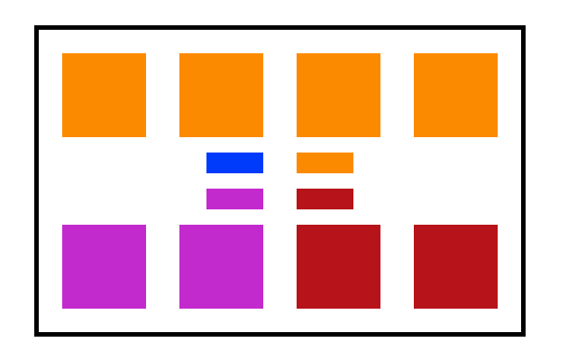
Computer Architecture
ρ-VEX : reconfigurable VLIW softcore
Notes:
Or 1 core with 4 pipelanes and 2 cores with 2 pipelanes,

Slide 54
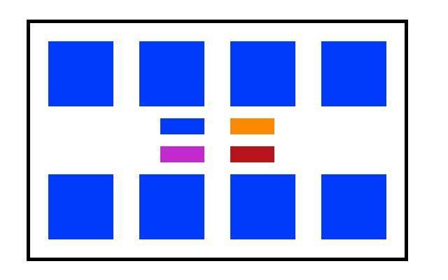
Computer Architecture
ρ-VEX : reconfigurable VLIW softcore
Notes:
Or an 8-issue core or any combination of this.
So if we have a program that does not have much parallelism, we will run it on a 2-issue core. This will save NOPs in the program and allows us to use the rest of the pipelanes for other cores. We can run 3 other programs at the same time!
If we have a scientific application that does matrix calculations, we can run it on an 8-issue core, maximizing performance for that program.
This is the way we are using hardware flexibility to optimize our softcore for a program.

